Slide 1
Beginning
Morse
Code
The first message ever sent using Morse code was "What hath God wrought?". This message was sent by Samuel Morse on May 24, 1844, from Washington, D.C. to Baltimore.
A few seconds later the reply arrived. "We've been trying to reach you about your car warranty."

Slide 2
TL;DR
www.keithford.com/files
Learn by sound only, no picture or word associations
Practice – Patience – Persistence
It’s not easy – take a friend

Slide 3
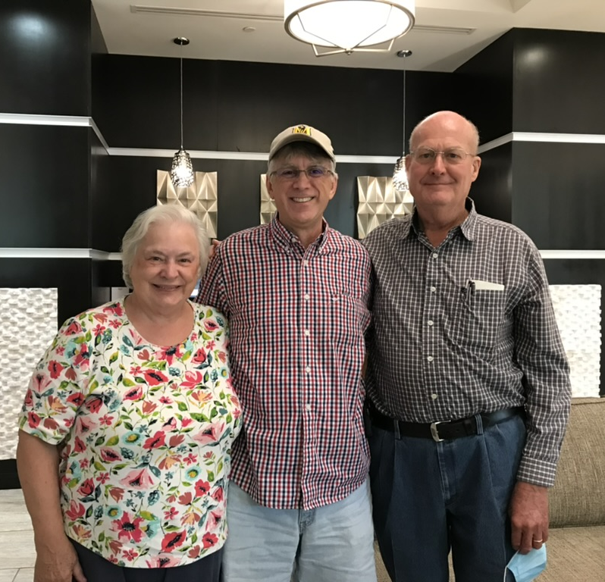
Hello
Keith Ford
K4KEF@keithford.com

Slide 4
Why Me? 😀
1983 – memorized 5wpm Morse code for Novice license

Slide 5
Why Me? 😮
1983 – memorized 5wpm Morse code for Novice license
1986 – started learning Morse code again

Slide 6
Why Me? ☹️
1983 – memorized 5wpm Morse code for Novice license
1986 – started learning Morse code again
2001 – let my license expire

Slide 7
Why Me? 😷
1983 – memorized 5wpm Morse code for Novice license
1986 – started learning Morse code again
2001 – let my license expire
2020 – Covid Summer >> Technician, General, and Extra

Slide 8
Why Me? 🧐
1983 – memorized 5wpm Morse code for Novice license
1986 – started learning Morse code again
2001 – let my license expire
2020 – Covid Summer >> Technician, General, and Extra
2021 – built Morserino-32 with Jerry (KF4BOE)
began learning Morse code again

Slide 9
Why Me? 🤔
1983 – memorized 5wpm Morse code for Novice license
1986 – started learning Morse code again
2001 – let my license expire
2020 – Covid Summer >> Technician, General, and Extra
2021 – built Morserino-32 with Jerry (KF4BOE)
began learning Morse code again
2023 – interested in QRP CW POTA
now I am learning Morse code…

Slide 10
Why Me? 🤪
1983 – memorized 5wpm Morse code for Novice license
1986 – started learning Morse code again
2001 – let my license expire
2020 – Covid Summer >> Technician, General, and Extra
2021 – built Morserino-32 with Jerry (KF4BOE)
began learning Morse code again
2023 – interested in QRP CW POTA
now I am learning Morse code…
2024
2025
again

Slide 11

Hello
Jerry Poplin
KF4BOE
My story is very similar to Keith’s

Slide 12
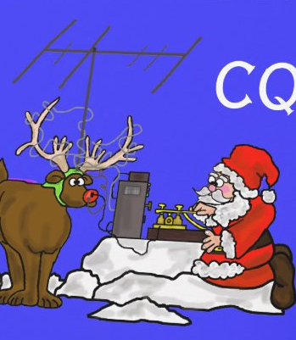
Why Learn Morse Code
Challenging ➔ Rewarding
POTA / SOTA / IOTA
More bang per watt – bandwidth 3kHz vs 100Hz
  Easier DX
  QRP (<5W) & QRPp (<1W)
Gear can be small, simple, and cheap

Slide 13
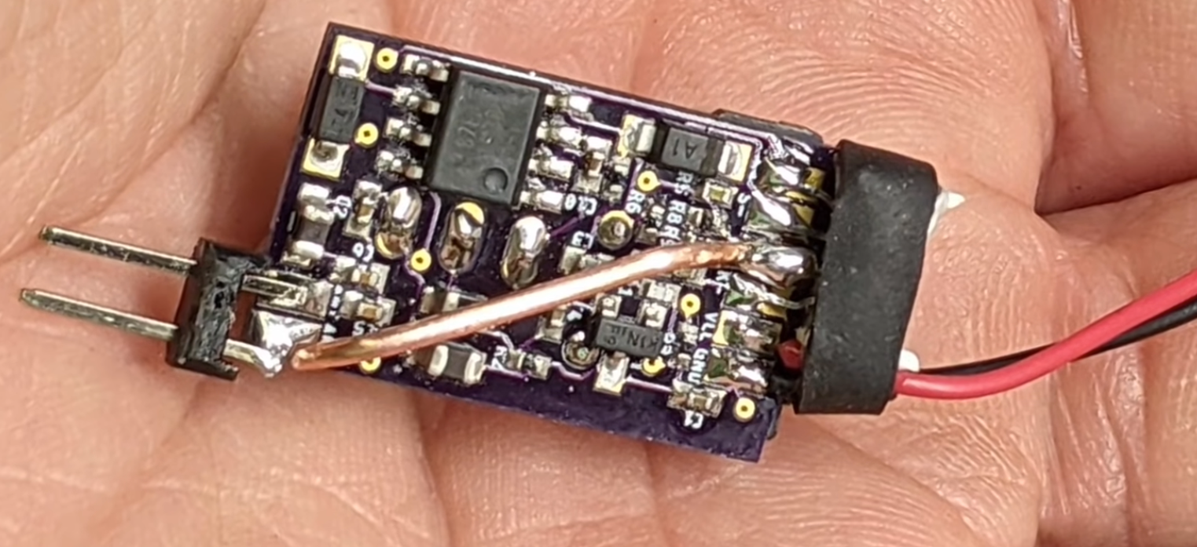
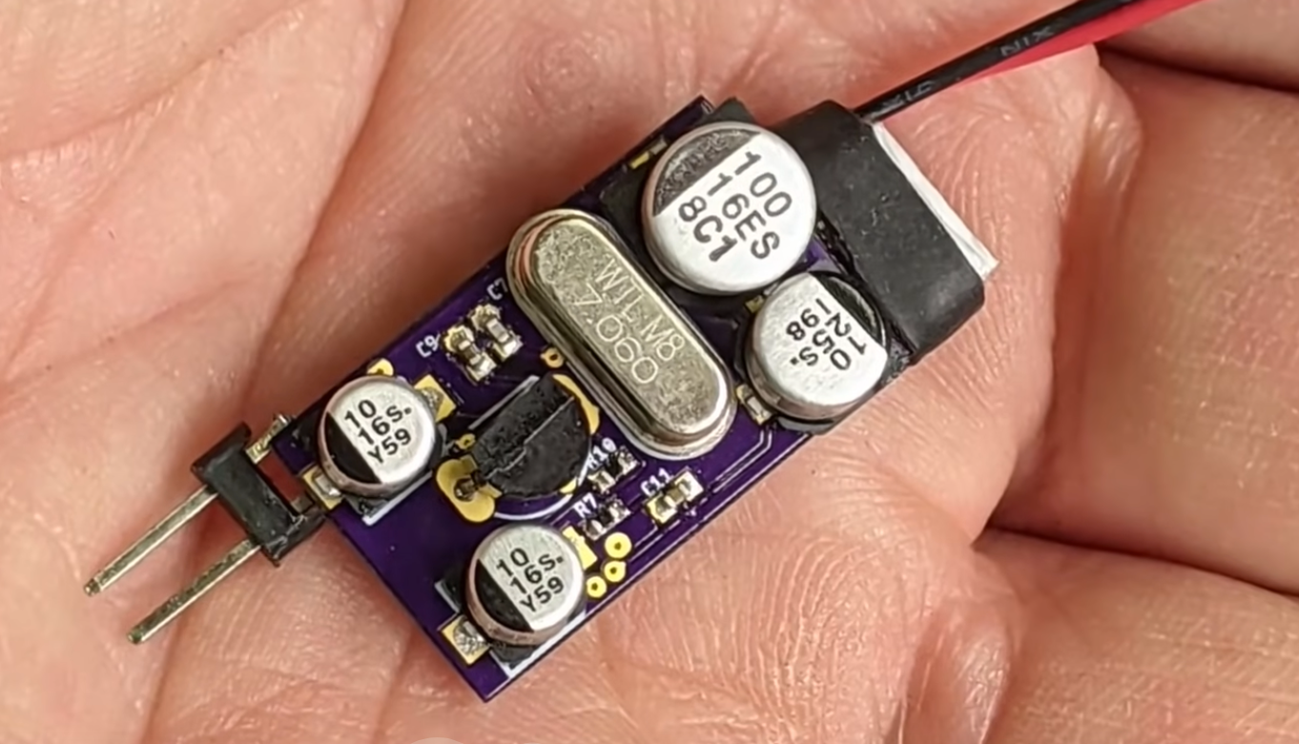
Micro SOTA
850 mW
2.7 grams
key ➔

Slide 14
It’s Magic
Modern, but old
Used by generations past
Free as in freedom

Slide 15

How NOT To Learn Morse Code
Morse code is an aural language, you need to learn it with your ears, not your eyes.
Do not use word or picture association
Attempts to learn it using any visual means may work initially but will most likely cause you to hit a wall when trying to increase your speed.

Slide 16
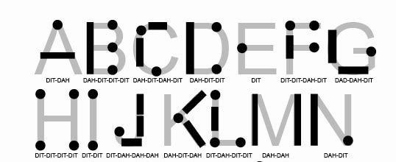

Slide 17
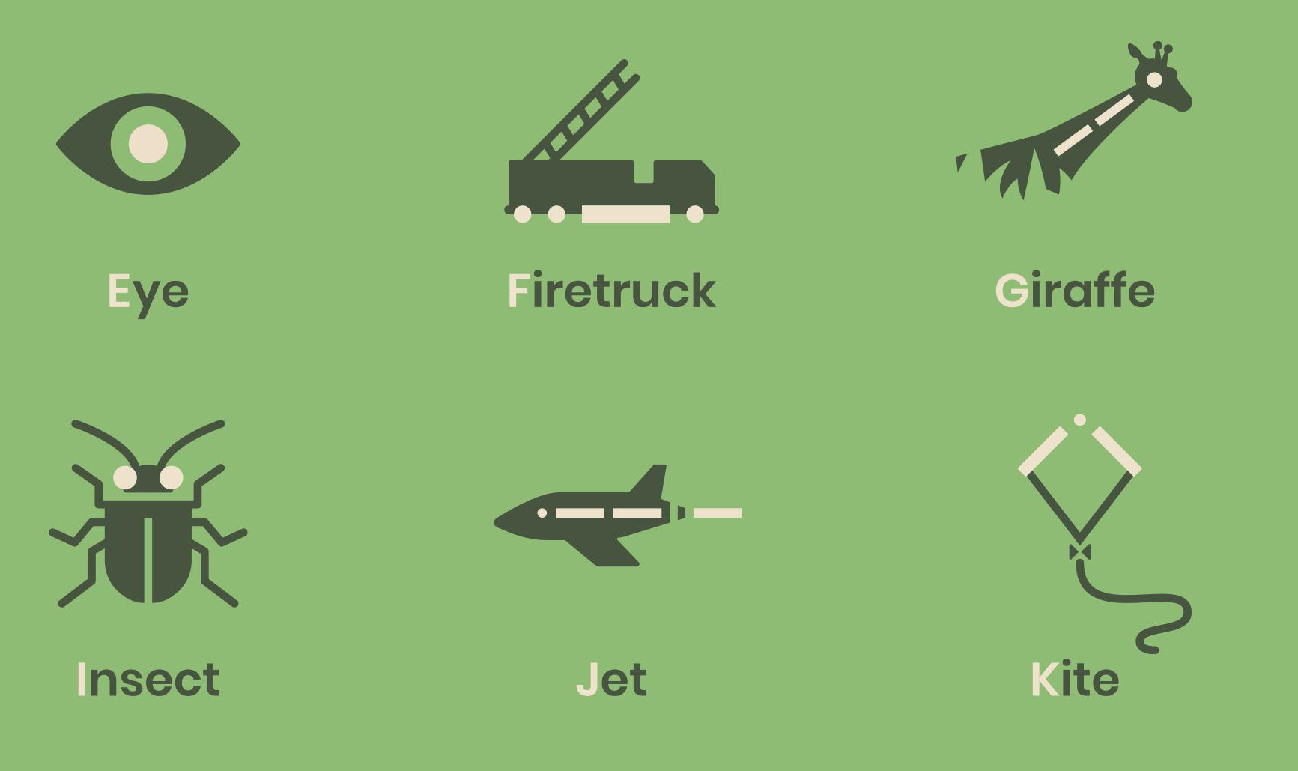

Slide 18
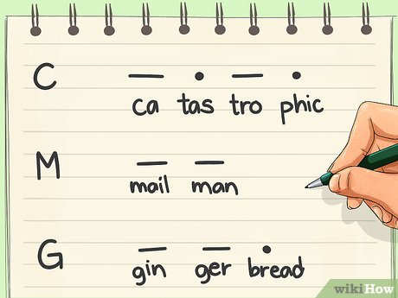
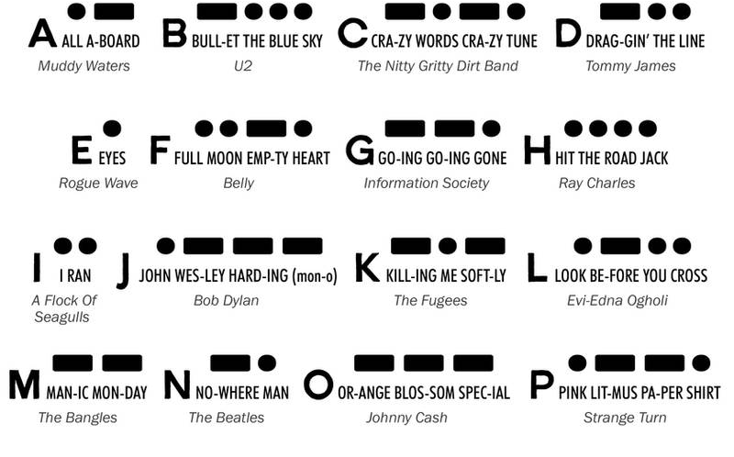
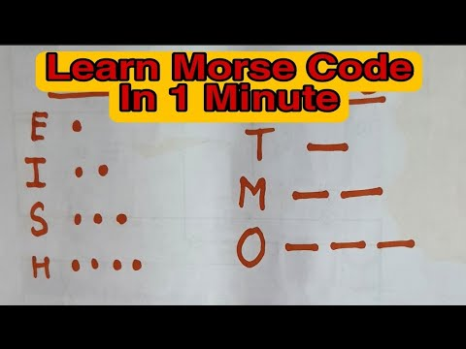


Slide 19


Slide 20
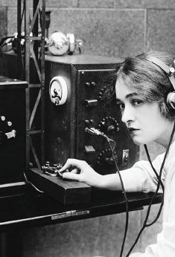
How To Learn
Morse Code
If you ask 10 people how to learn Morse code, you'll get 12 answers.
Practice
Patience
Persistence

Slide 21
Methods
Learn by sound of the letter (do not count dits & dahs)
  L is not “dot dash dot dot”, but “di-dah-di-dit”
Koch – learn characters in certain order, start with two, add more as you become proficient
Farnsworth – target character speed, adjust character spacing
  20/10 is common, we suggest using 30wpm character speed
Most Apps support Farnsworth and Koch
Now, what is character speed and WPM?

Slide 22
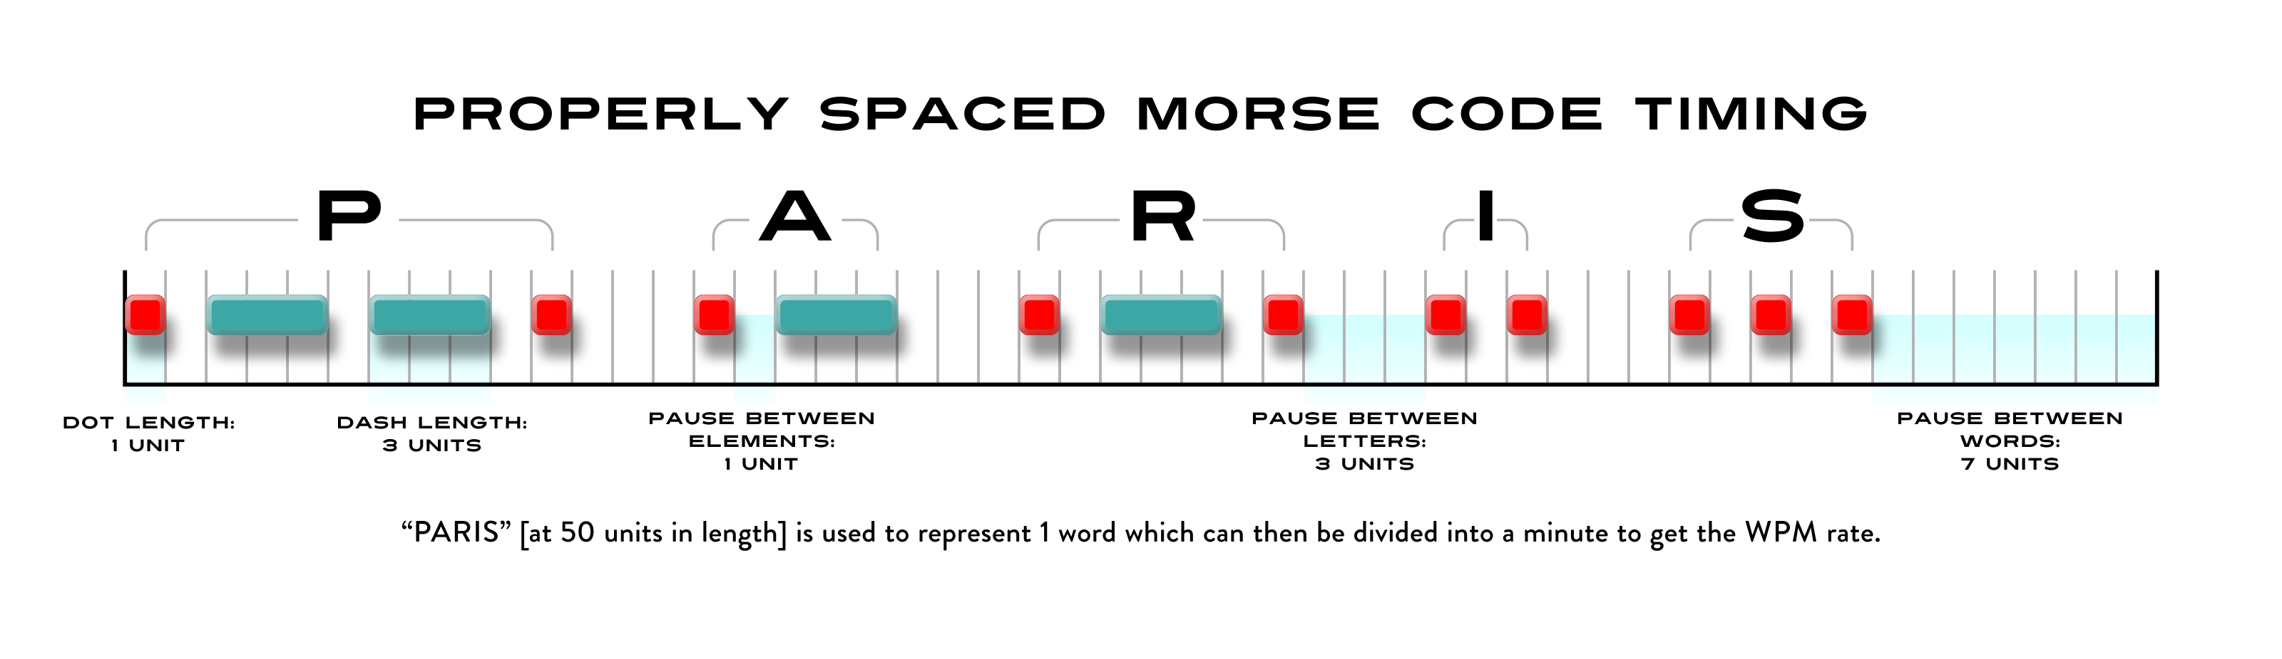
What is Morse Code?
di - dah - dah - dit di - dah di - dah - dit di - dit di - di - dit

Slide 23
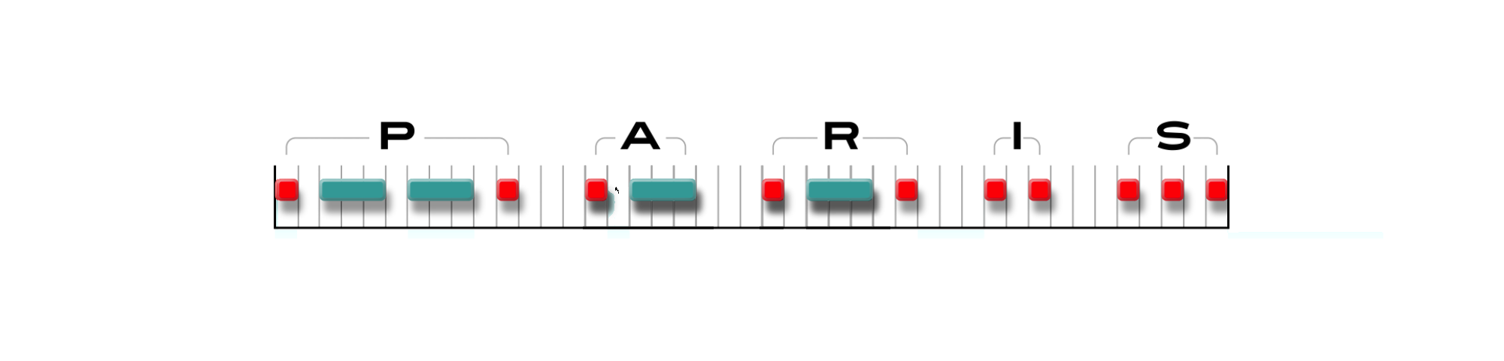
How Does Farnsworth Help?

Slide 24
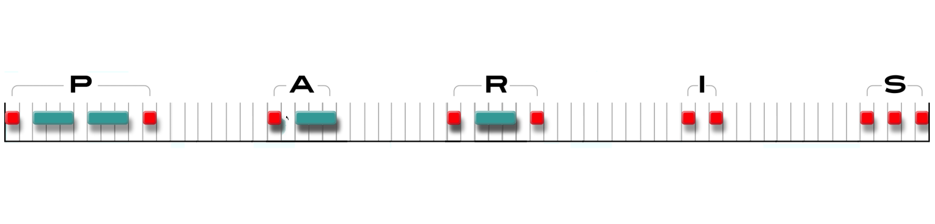
How Does Farnsworth Help?

Slide 25
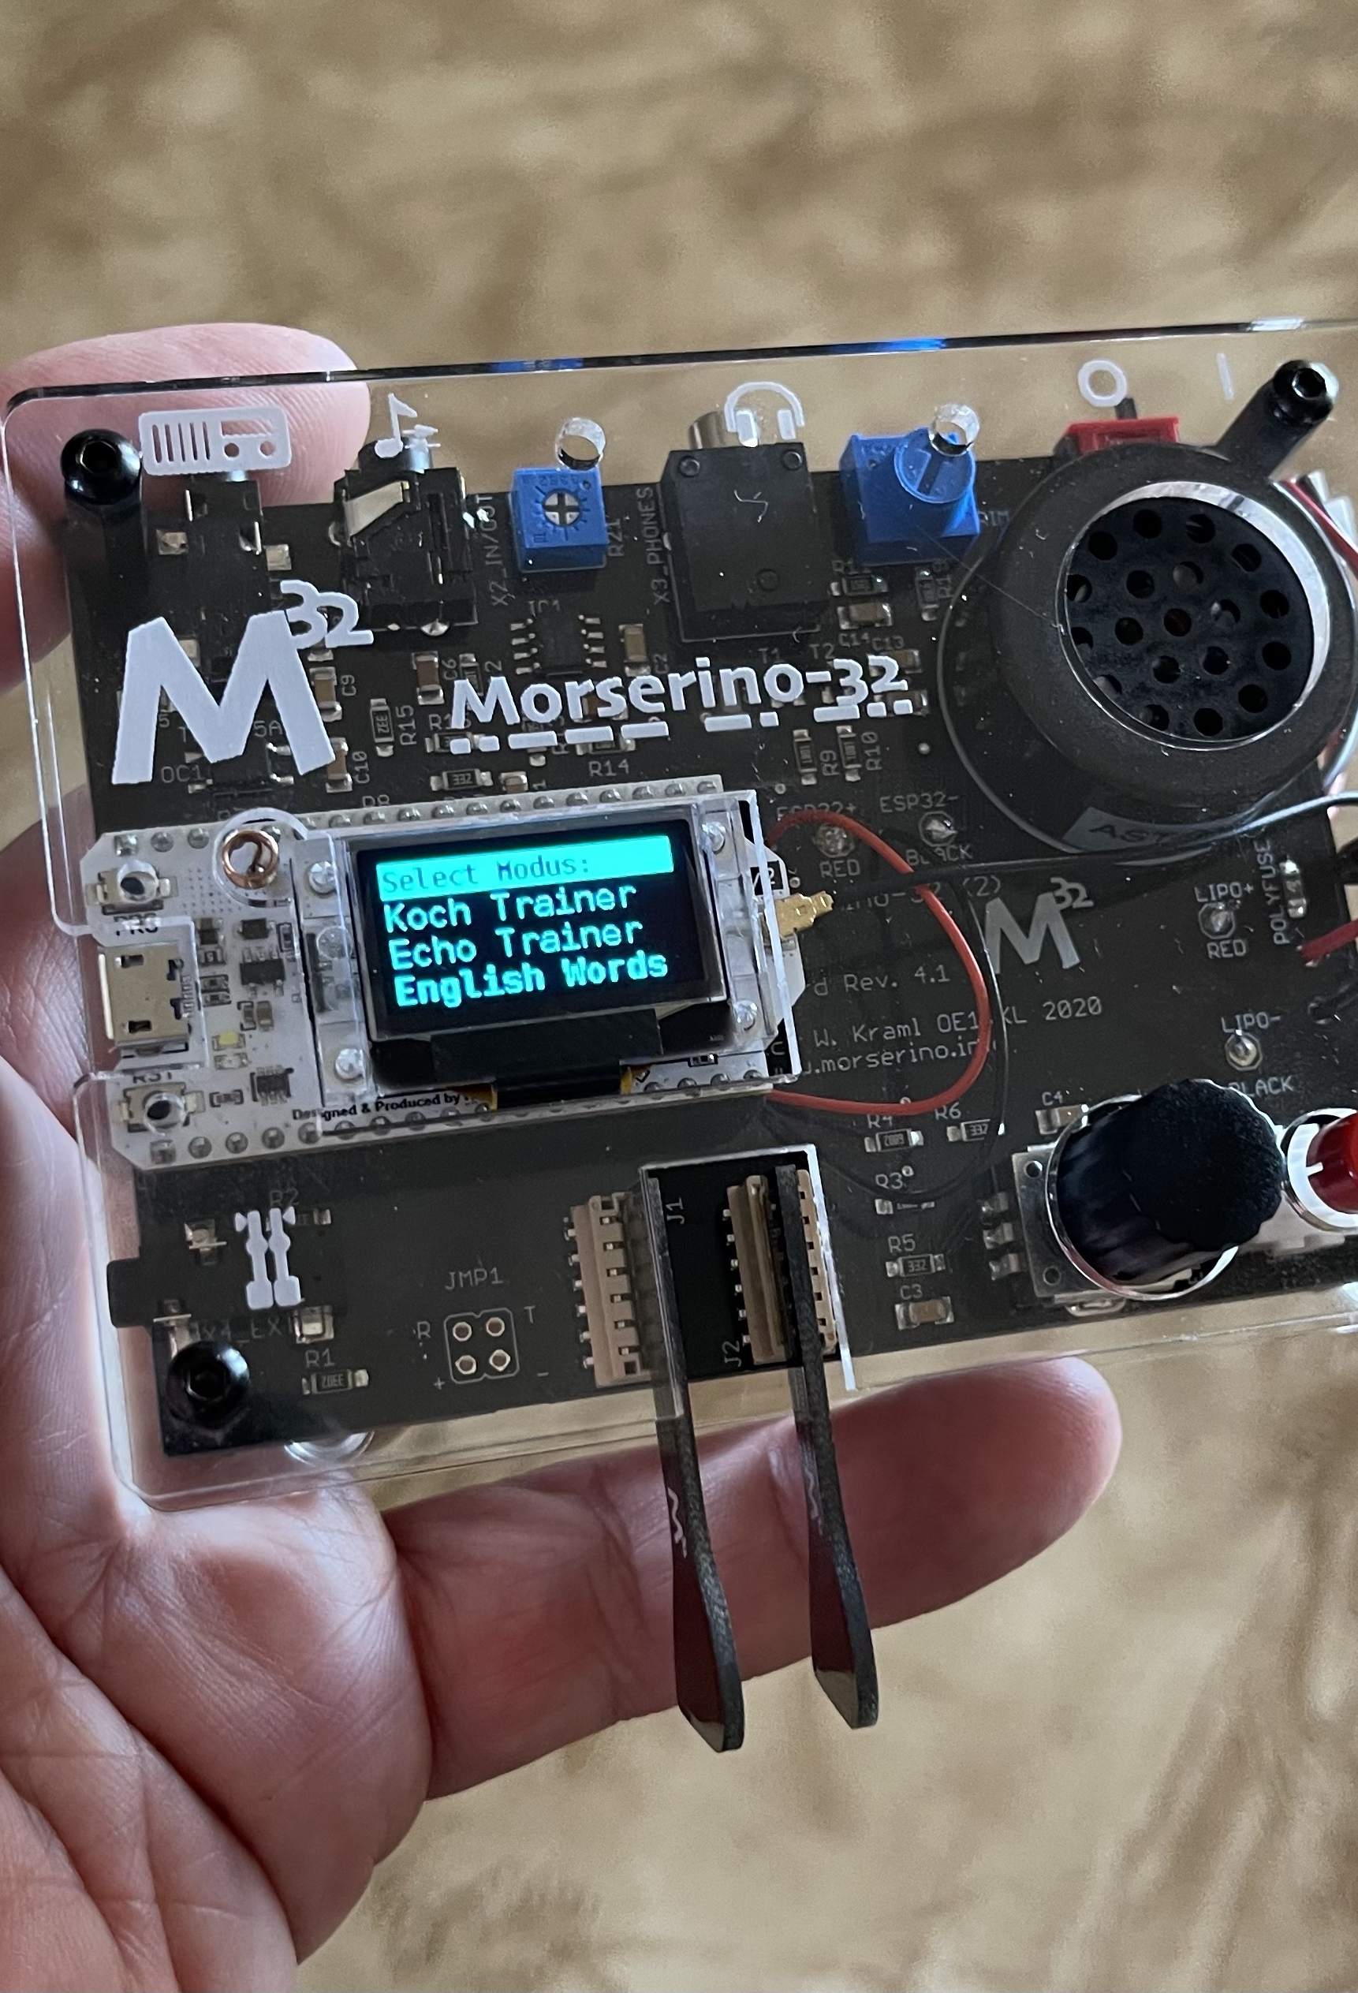
Helpful Tools
Hardware
  Code Practice Oscillators
  Decoders
    Practice correct timing when learning to send with a straight key
  Morserino-32 kit
    Koch Trainer, Echo Trainer, CW Decoder
    CW Transceiver using WiFi
    qsobot.online

Slide 26
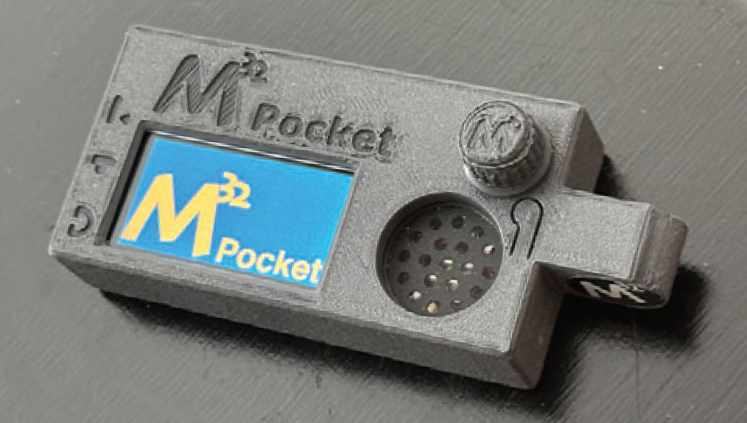
M32 Pocket
“We are currently testing the final prototype - that should be done by the end of the month. I cannot say right now how long procurement of PCBs and other parts in sufficient quantities will take, but it should not be too far out!” Willi 2025-07-18
flyer on web site

Slide 27
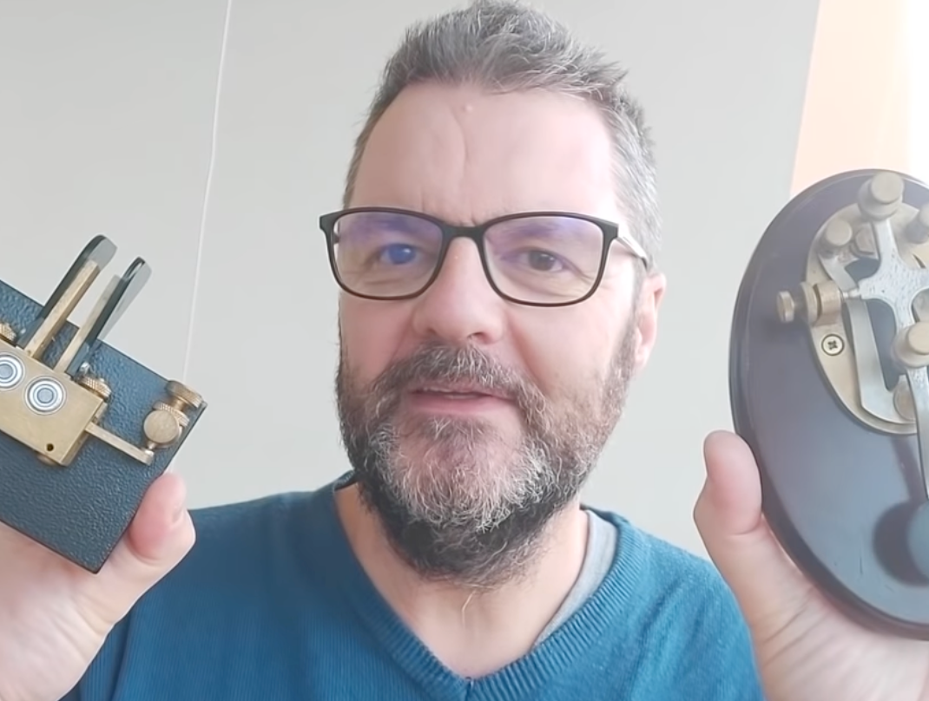
Sending:
Key vs Paddles
Be comfortable with copying code before you start to practice sending.
When one uses a straight key, one must use precise timing since the code is produced by physical manipulation. A paddle is different from a straight key since the difference in timing between the “dits” and the “dahs” is built into the unit.
Learn sending with a straight key to ingrain these timings.

Slide 28
Apps
Web Apps
  lcwo.net
  longislandcwclub.org
  morsecode.ninja
  morsecode.world
  learnmorsecode.org
Mobile Apps
  Morse Maven
  Ham Morse
  Morse Toad
  Morse Machine
  Morse Mentor Pro
  Morse Mania
Desktop Apps
  CW Trainer by G4FON
Some apps will send real QSOs, current headlines, and let you upload your own content.
They can also simulate real listening conditions such as band noise and signal fade.
Warning about keyboard usage
with some apps

Slide 29
Tips
Use both Koch and Farnsworth methods at the same time.
Practice 10-15 minutes twice a day.
* Habit Stacking *
CW operators will have “accents” so listen to real QSOs.
No radio? Try websdr.org
Find slow operators at hamalert.org
If you struggle, seek a practice buddy or join an online CW club. This can add even more fun.

Slide 30

LICW
TEACHERS of Morse Code
Scott Wooten, KW4NJA
Notes:
Today I would like to tell you about the Long Island CW Club and the renaissance of Morse Code

Slide 31
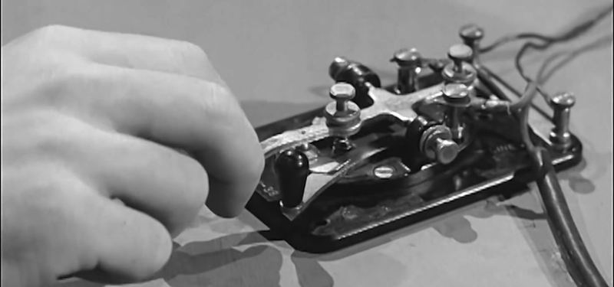

A Little Bit About Our Club
Founded in 2018
More CW operators needed / Field Day in 2017
A way to give back to the community
Goal: 50 members / Long Island area
More successful than we ever dreamed
Over 6000 members
All 50 US States
Over 60 countries around the world
Over 100 Instructors and Moderators
Over 150 Classes/Forums weekly on Zoom
English & Spanish

Slide 32
Club Resources
LICW YouTube Channel
LICW Newsletter
LICW Facebook Page
LICW This Week Podcast
LICW Discord Server (Chat, Sked)
LICW DMR: TGIF Network, Talk Group
LICW Dropbox
LICW Groups.io
LICW Morse Practice Page
LICW VBand Channel Page
LICW Challenge Page
LICW Academic Downloads

Slide 33
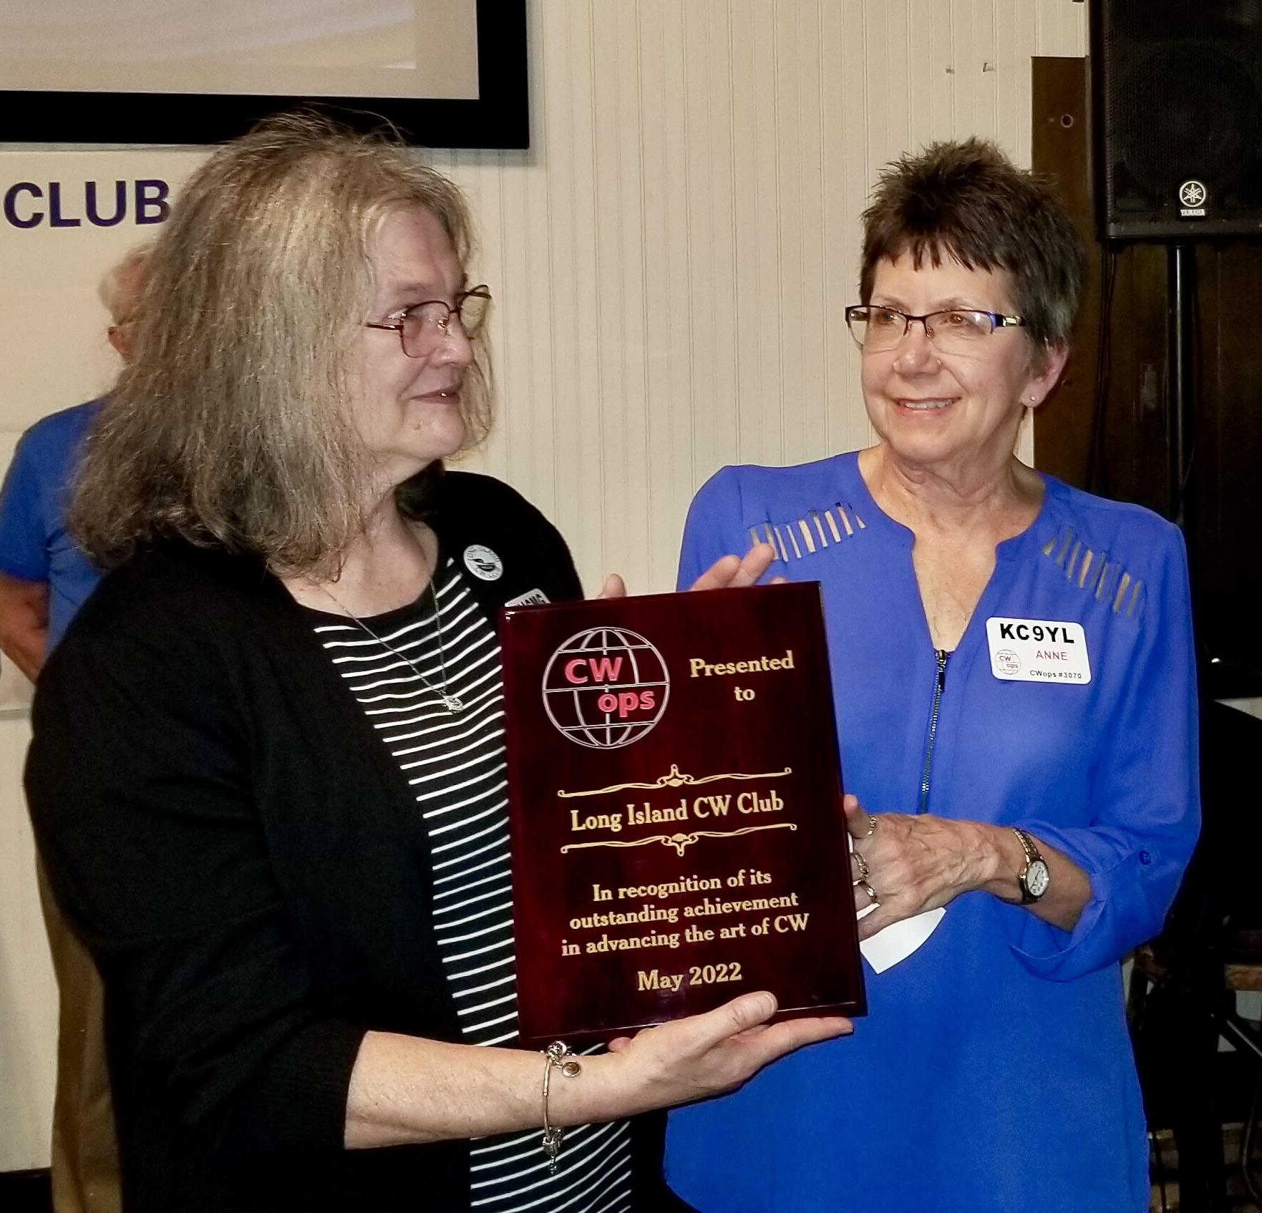
OVER 400 Yl’s
Instructors
Moderators
Other leadership roles
Cathy W4CMG & Anne KC9YL accepting award on behalf of LICW

Slide 34
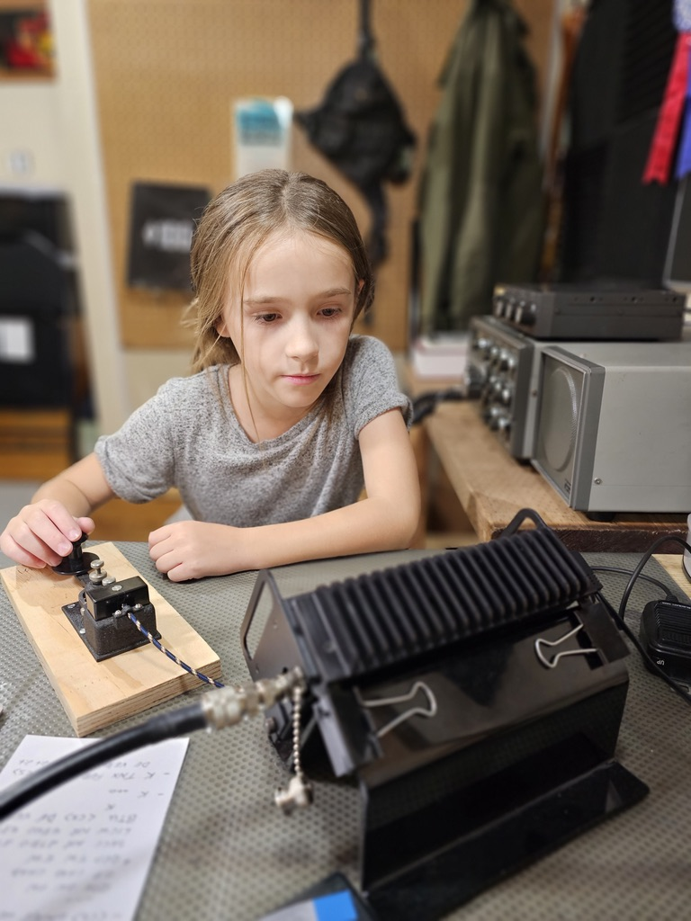
Kids Program
Developed during COVID
Ages 5 to 17
Half of our students are girls
Students from U.S., Canada, U.K., and Hungary
Adult curriculum modified for how kids learn
Over 600 kids have learned CW so far

Slide 35

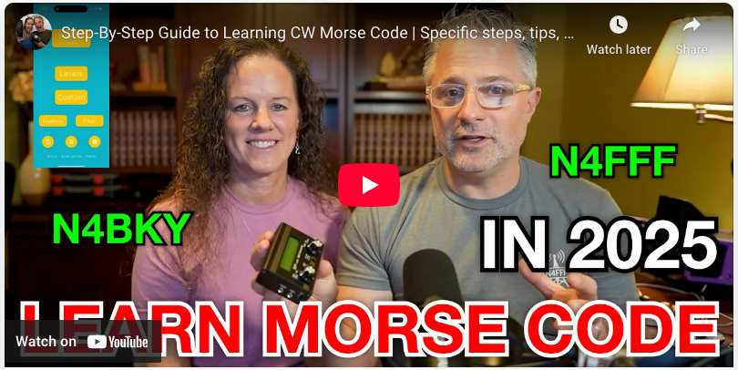
HamRadioDuo
Mike N4FFF and Becky N4BKY
Notes:
Hi, we’re Mike and Becky. You might know us from YouTube as the HamRadioDuo!
… pleasantries and introduction

Slide 36
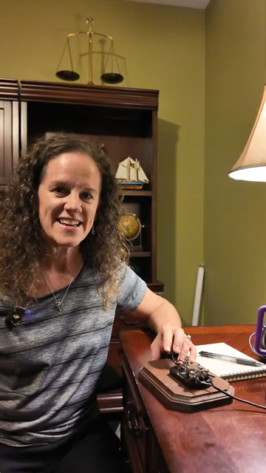
Fun
Notes:
Try to play this 1 minute video with clips our our adventures.
As Keith and Jerry have shared, there really is something special about morse code and CW. Morse code unlocks being able to use tiny radios, which in turn unlocks being able to bring them anywhere including outdoors to the park, hiking, the beach, and so much more.
We started our channel so that we can share how much fun we are having. We also started our channel to share our challenges along the way.
Mike learned what he believes is the hard way. Becky learned a what we think is a faster and easier way.
Mike learned by memorizing the dits and dahs. After tons of work to get there, he couldn’t actually copy anything of appropriate speed. He eventually gave up and put the radios in a drawer.
Becky wanted to learn just for the challenge, Mike picked it back up but searched for a better way. This time, Becky started off with the new methods and Mike re-learned.
We share our journey so that people can see the reward of how fun it is and encourage anyone who wants to learn.

Slide 37
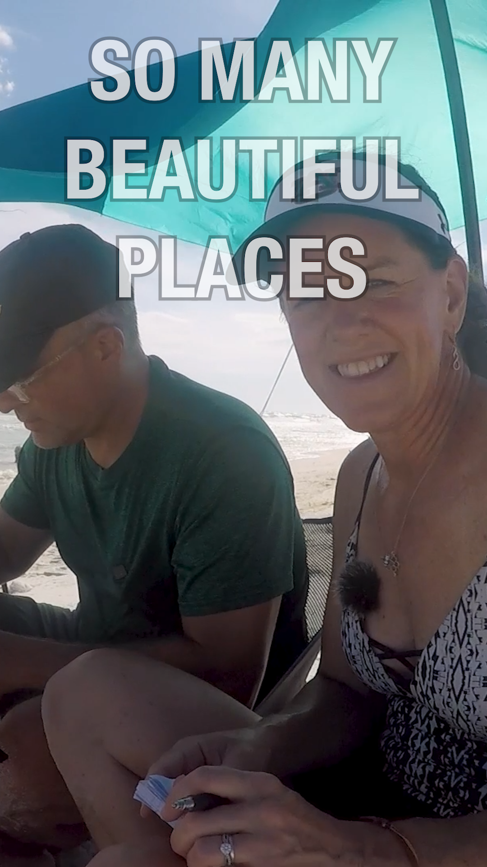
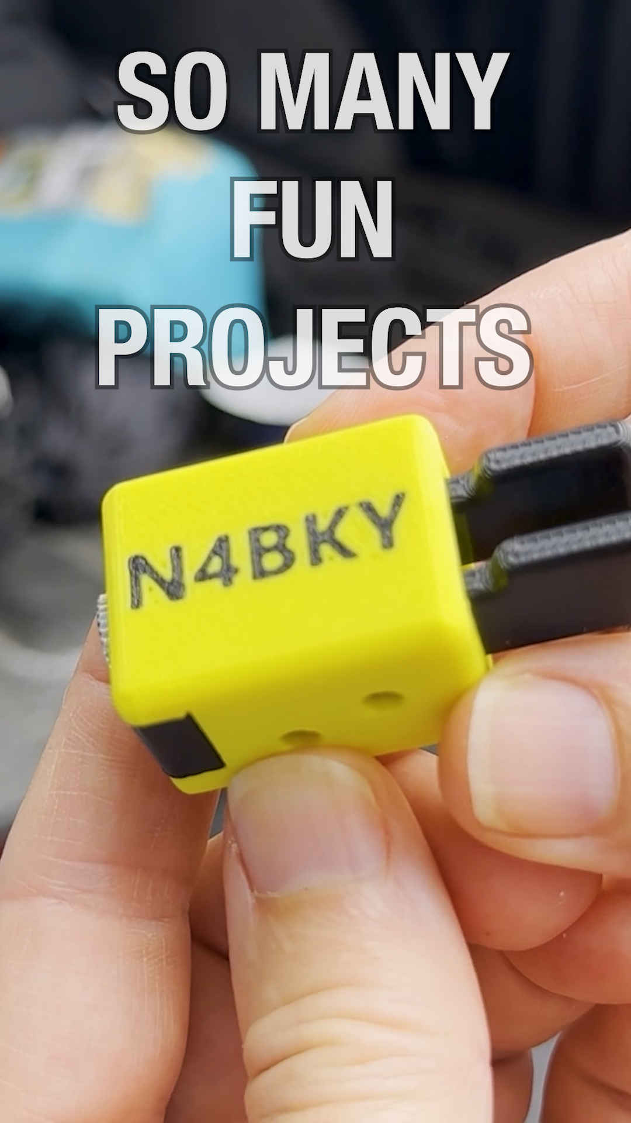
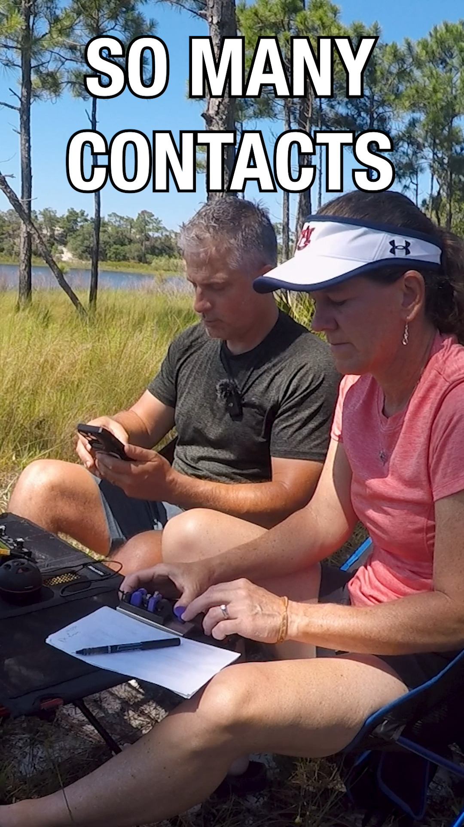
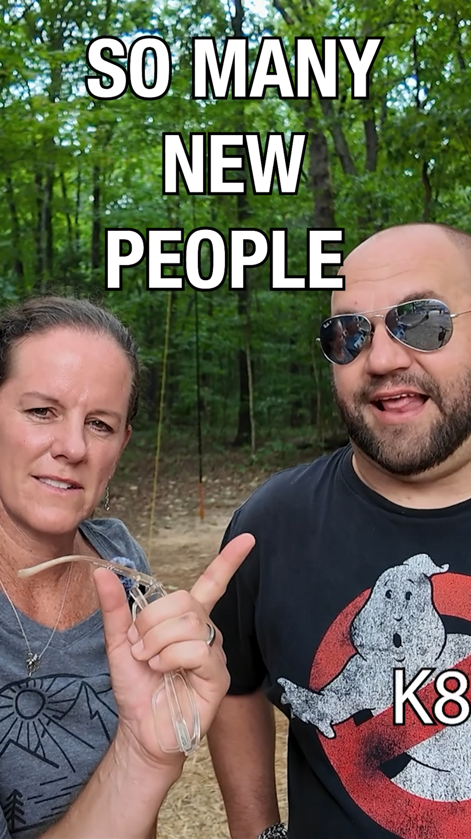
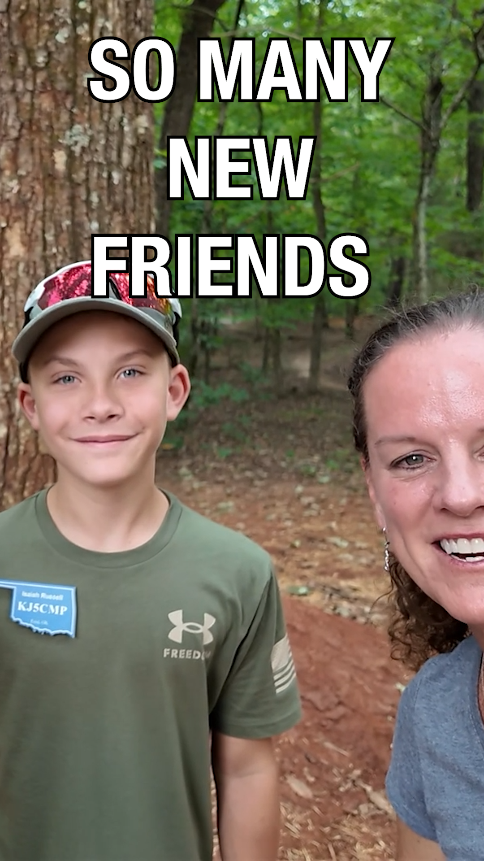
Fun (in case we can’t play the video)
Notes:
If the video on the previous slide doesn’t work, just talk to the slides.

Slide 38
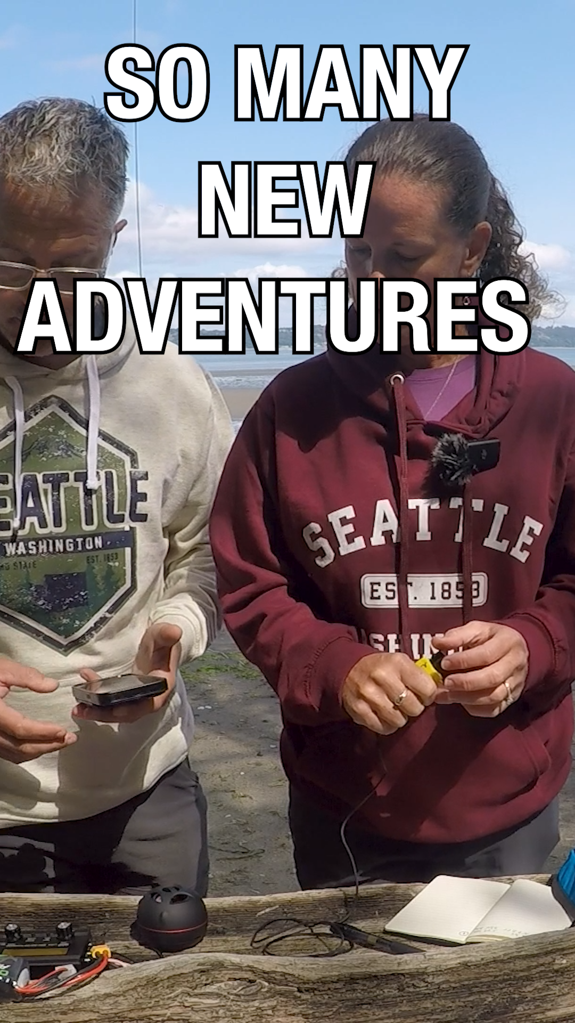
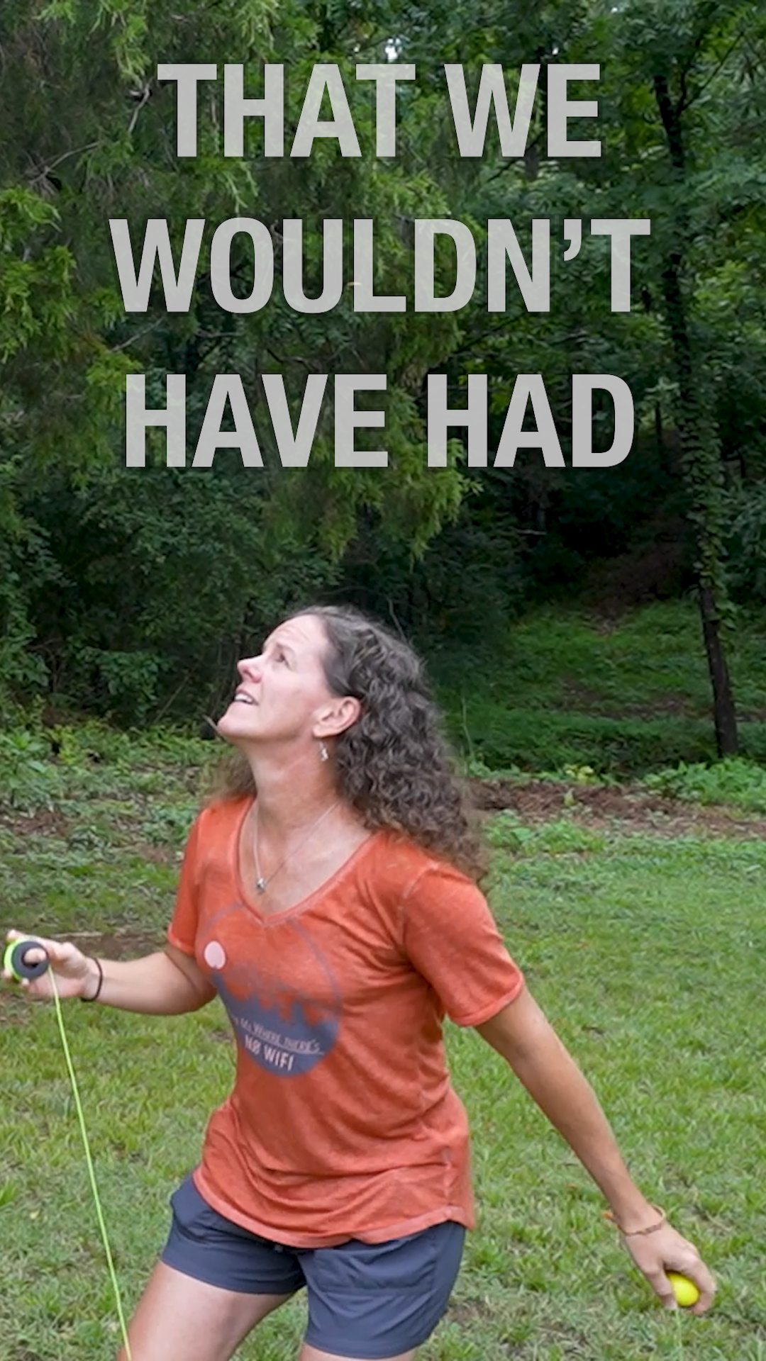

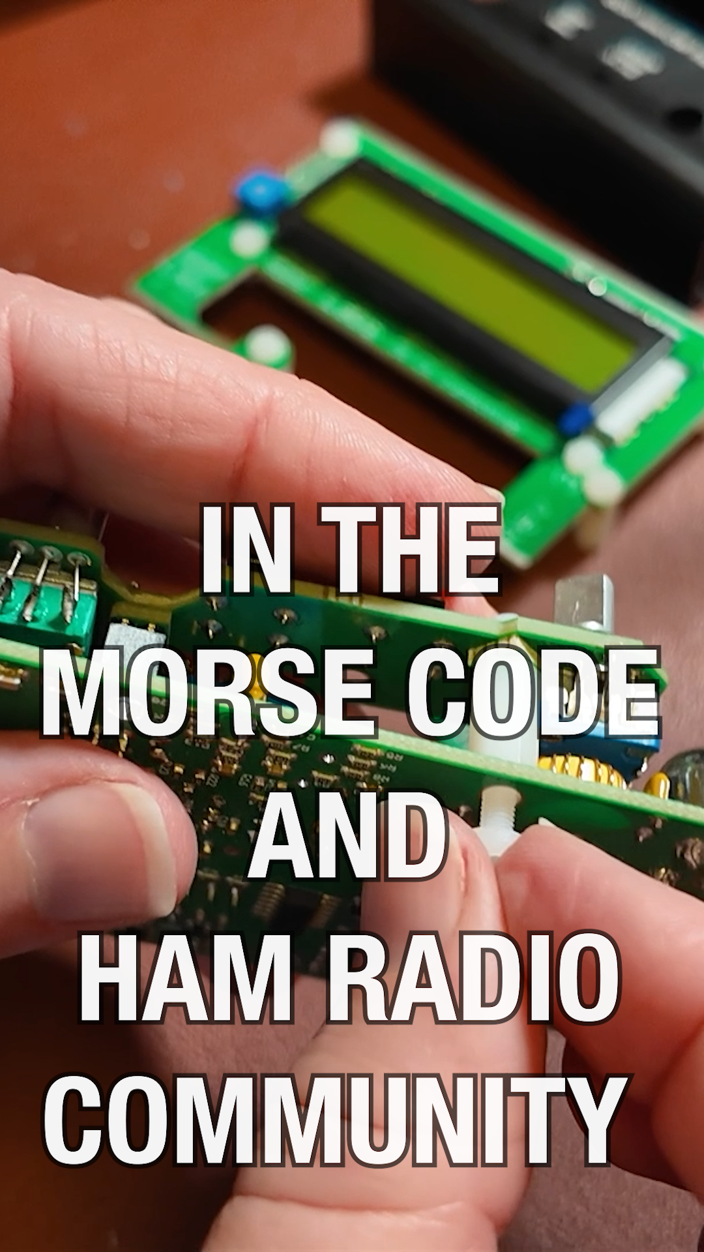
Fun (in case we can’t play the video)
Notes:
If the video on the previous slide doesn’t work, just talk to the slides.

Slide 39
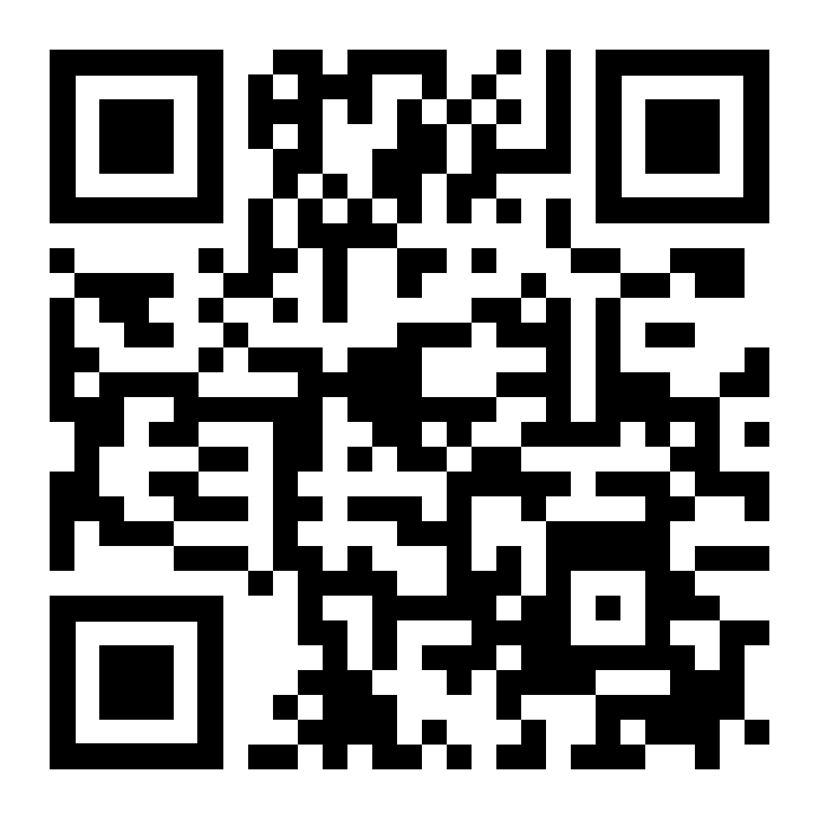
Getting Started
learnmorsecode.org
for anyone wanting to learn
why
learning
getting licensed
tools and games
classes and clubs
Notes:
We’ll wrap up with this. We created a website, learnmorsecode.org, to have everything we would have wanted to know. We made it so that anyone who loves morse code could share it with anyone who expresses interest. It starts with the why, outlines how to learn, getting licensed, links to tools and games, and lists the many fantastic classes and clubs.

Slide 40
First step to learn morse code
Our recommendation: Morse Mania
Makes learning a game
Learn by sound (set character speed to 30wpm+)
Don’t aim to get 100% right – just get 50-70% right
Have fun!
Notes:
If you want to learn morse code and walk away remembering just ONE THING, this would be it (from us). Just get started. Grab Morse Mania, set it to 30wpm, and learn.

Slide 41
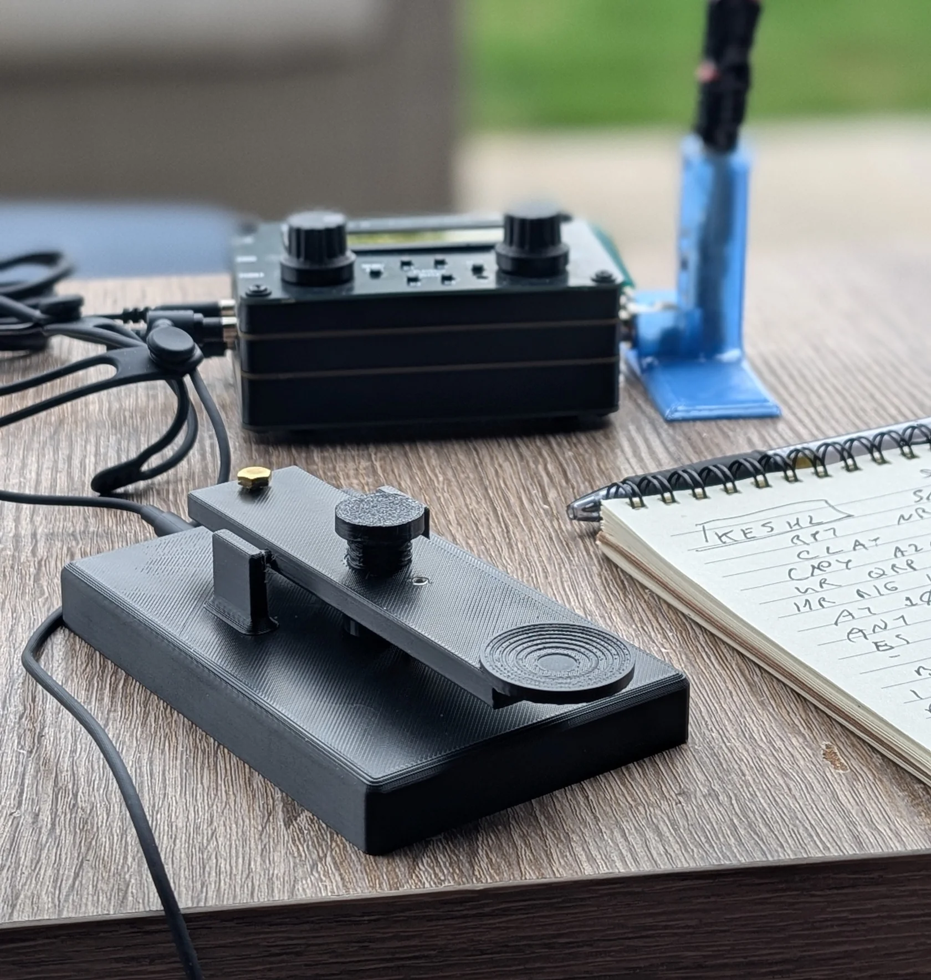
One more thing: Our Key
We made a key, the Duo Straight Key One.
shop.hamradioduo.com
Notes:
Oh yay, and if you haven’t seen it. We made a key.
Thank you everyone.

Slide 42
Questions?
Practice, patience, and persistence are the keys to mastering any language.
— Sandrine Elliot

